Slide 1
Virtual Future Heroes – Nursing Hello and welcome!
The session will begin shortly
Please mute your mics and switch off your cameras.
If you need technical assistance please use the chat box and we will be happy to help.

Slide 2
House Keeping
Please mute your microphone and turn off your cameras. This will help us manage background noise during the presentations.
Please do not take any recordings or screen shots of the screen during the session
If you need any technical help during the event please message us using the chat box.
If you would like to ask a question please use the chat box.
The session will be not be recorded live but we will be uploading the presentations to the Extra Heroes webpage after this session.
Please bear with us if there are technical issues we will resolve them as quickly as possible. You may find that some of the videos we play may buffer, we will share the links after the event for anyone who had any issues watching them.
Social media – please tag us in @hwe_academy and use the #Future Heroes
Please join in with the quizzes and activities
Your feedback is important to use please feel free to email us – academy.hwe@nhs.net

Slide 3
Mental Health Nursing Communication skills in practice.
A nurses view whilst working with people with a diagnosis of Dementia for 19 years

Slide 4
3 minutes dementia experience!
I will need 1 volunteer thank you….
to interrupt me when I’m talking every 15 seconds.
Clap every 30 seconds
Slam the door (not too hard) every 60 seconds.
Whilst I read out a letter to you all

Slide 5
What went wrong during the 3 minutes.
For me without a cognitive impairment, I found this very difficult, I lost my train of thought, I didn’t feel valued as when I was talking I was being interrupted.
I was nervous about speaking in front of a lot of people like service users would be, and wanted to make a good impression.
I deserve to have time to speak, can you think of a time when you are in a care setting, and someone tells you I'll be 5 minutes, and comes back after an 30 minutes, how frustrating that is. Service users are dependant on us and vulnerable, always make time to stop and listen to your service users and make it a daily priority.

Slide 6
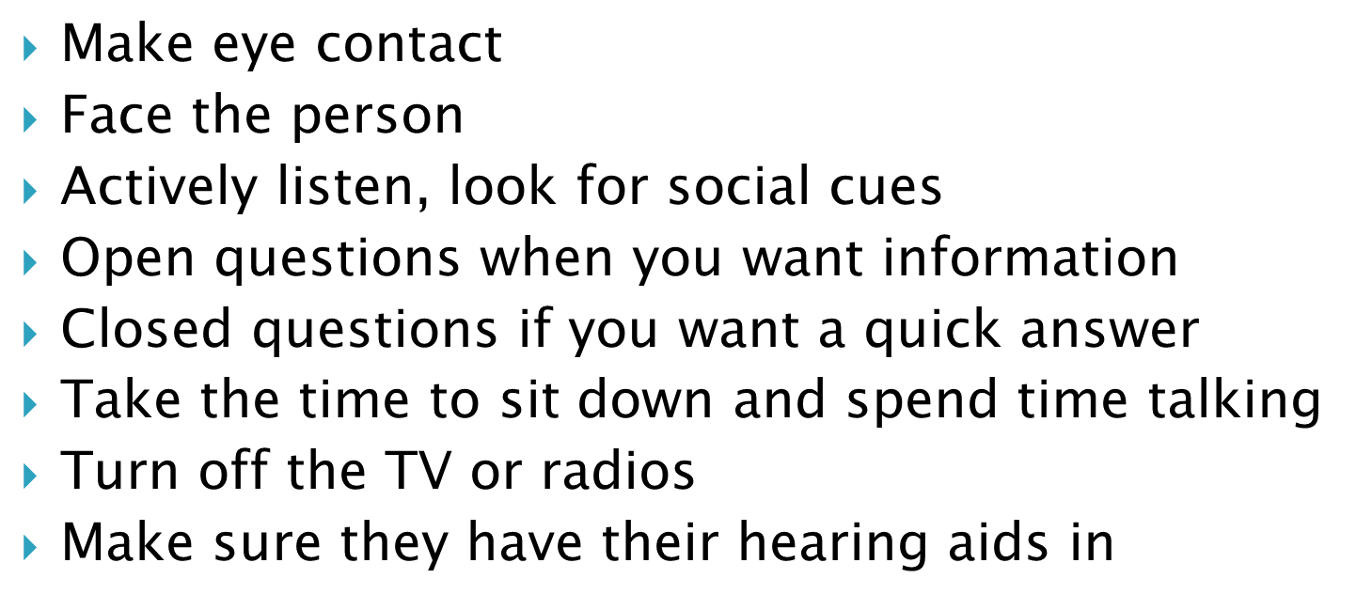
Communication skills tips

Slide 7
Short case study on Sheila
Sheila was a 77year old lady with a diagnosis of dementia.
She was admitted to an inpatient ward because she would try and leave her residential home during the day, jumped the fence to escape, screamed at night and would cry when it was dark.
Sheila has expressive dysphagia and the only things that would console her was her family.

Slide 8
Communication
I spent time with Sheila completed an ABC chart and noticed that she would try to leave at 3pm everyday. We tried to occupy her at this time but it didn’t help, so I went with her, opened the door and walked with her outside the building with agreement from MDT and family. Sheila was actually walking to the school to pick her kids up. As we walked she had reality orientation and understood the kids are now grown. Now at 2:30pm we get her photo albums, have a cup of tea and she realises all over again her kids are grown up, and she no longer tries to leave.
I used the same technique at night with the photo album but Sheila was more confused at night, and could not make sense why her kids were not with her at night. We communicated with her family and OT and nurse and tried Doll therapy. Sheila now sleeps with her doll, she comforts it as a baby and doesn’t scream as she doesn’t want to wake the baby.
Cont….

Slide 9
Now Sheila has a restful night, she wakes up in a brighter mood, she no longer tries to leave and can be discharged from hospital.
The assessment is communicated through the care plan and community nurse and family, so they understand all of her needs.
This is a person centred care plan which identified what is important to Sheila
Communication is key, even if you cant verbalise. Taking the time to use your communication skills, body language and kindness is just as important.

